Slide 1

ECEN 361
Real-Time and Embedded Systems
Lecture 2 – Processor HW

Slide 2
Components of Embedded Systems
Power Supply, Reset and Oscillator Circuits
Input Devices interfacing/Driver circuits
System Application Specific Circuits
Processor
Program Memory and Data Memory
Timers
Serial Comm. Ports
Interrupt Controller
Parallel Ports
Output Devices interfacing/Driver circuits

Slide 3
Creating the Hardware of Embedded Systems
Three Choices:
Create your own design
Choose the processor architecture
Choose the additional on-chip capabilities
Use a reference design for the System
Use an already existing System Design
Choose the processor
Use an already existing hardware implementation
Use an FPGA implementation
Choose the processor
Create an FPGA implementation of the System

Slide 4
Creating the Hardware of Embedded Systems
Choose the processor architecture:
8051 – Intel dedicated microcontroller. Very old-school
PIC Processor – Small, dedicated processors. Use a dedicated IDE.
AVR Processor – Sometimes call the ATMEL processor – Heart of the Arduino UNO.
ARM Processor – Various Families, including the Cortex – Higher end processing power.
Freescale – An old Motorola design.
x86, Quark – Intel standard architectures

Slide 5
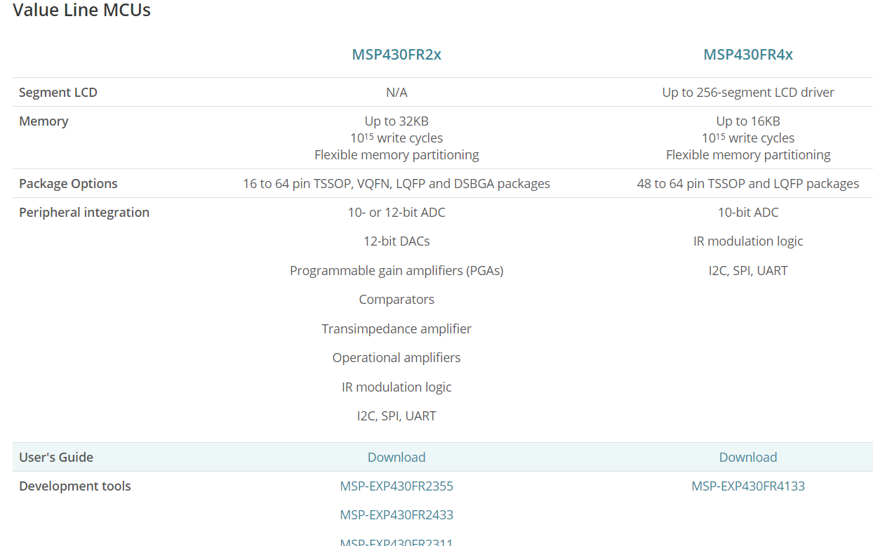
Creating the Hardware of Embedded Systems
Choose the additional capabilities that you want on the processor chip:

Slide 6
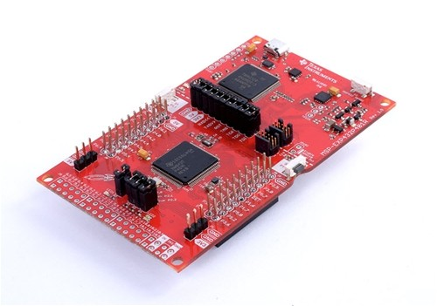
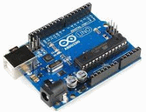
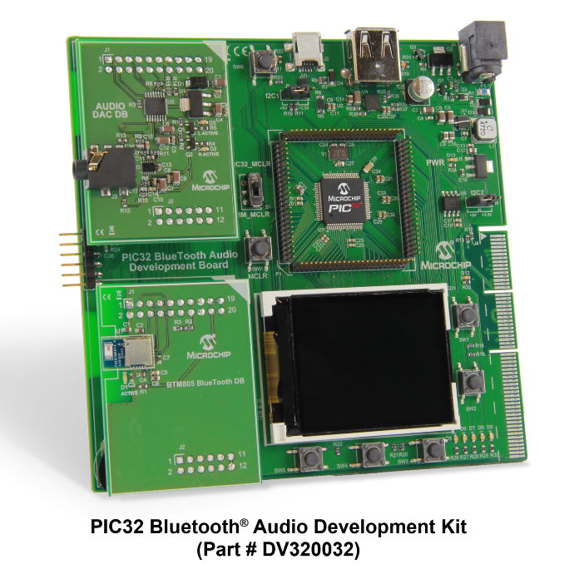
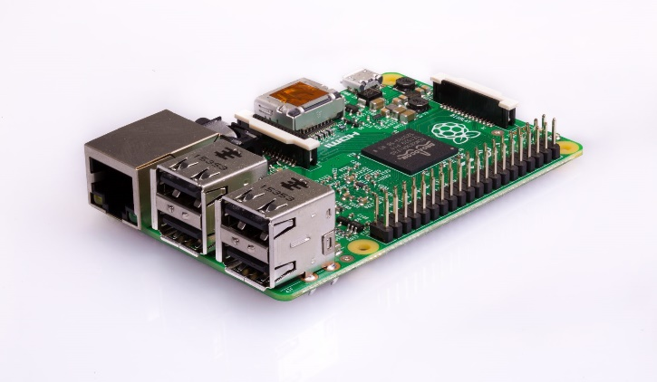
Creating the Hardware of Embedded Systems
Choose a standard development hardware package:

Slide 7
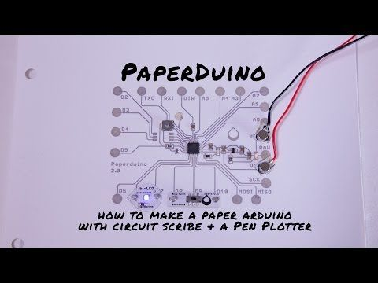
Creating the Hardware of Embedded Systems
Or choose your reference design

Slide 8
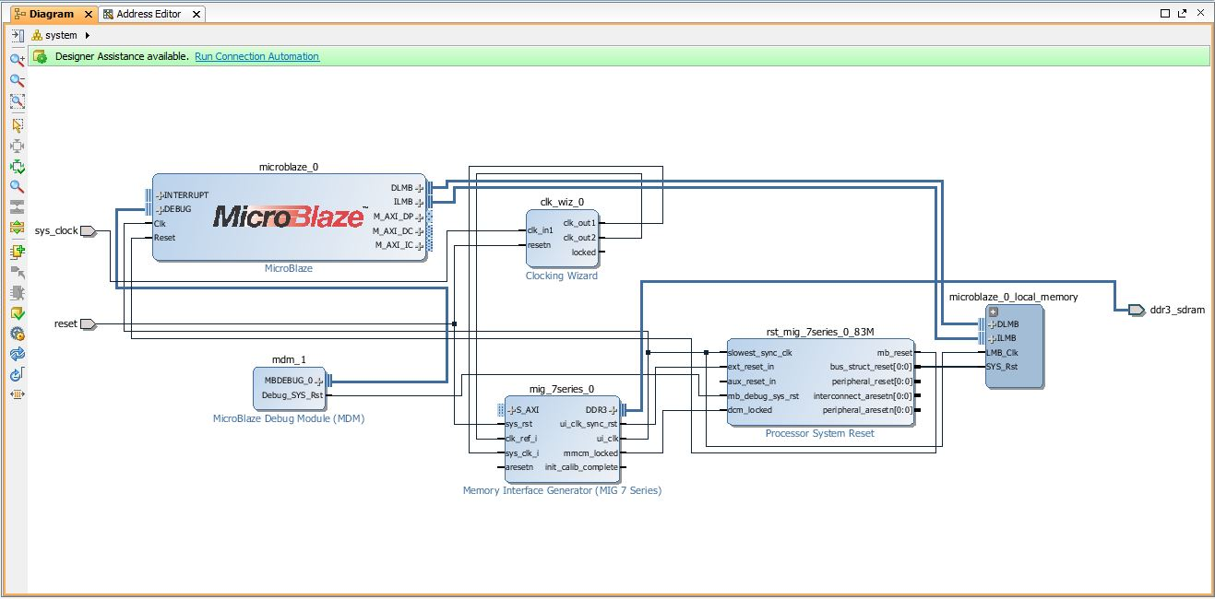
Creating the Hardware of Embedded Systems
Or add a Microprocessor IP to an FPGA design

Slide 9
Factors in Choosing the Hardware
Capability
Price
Size
Power Consumption
Software Development Environment

Slide 10
Factors in Choosing the Hardware
Really Cheap, simple, single thread type implementations:
MSP430
AVR/ATMEL
PIC
Normally small size, small memory size, low power consumption

Slide 11
Factors in Choosing the Hardware
Larger, more memory, more capability (simple RTOS).
ARM
AVR/ATMEL
PIC
Still small size, a bit larger memory size, a bit higher power consumption

Slide 12
Factors in Choosing the Hardware
Even larger, 1 GByte memory, more capability (linux).
ARM (Cortex)
Quark (Intel)
Freescale
Small computers running complex systems.

Slide 13
Software Development Environment
Perhaps the Biggest Factor in Choosing the hardware is choosing the Software used to develop your application

Slide 14
Software Development Environment
Really Cheap, simple, single thread type implementations:
MSP430 - Code Composer
AVR/ATMEL - Arduino IDE
PIC - MPLab

Slide 15
Factors in Choosing the Hardware
Larger, more memory, more capability (simple RTOS).
ARM - Keil, CC, GNU Eclipse
AVR/ATMEL - Arduino IDE
PIC - MPLab

Slide 16
Factors in Choosing the Hardware
Even larger, 1 GByte memory, more capability (linux).
ARM (Cortex)
Quark (Intel)
Freescale
Keil, VxWorks, RT-Linux

Slide 17
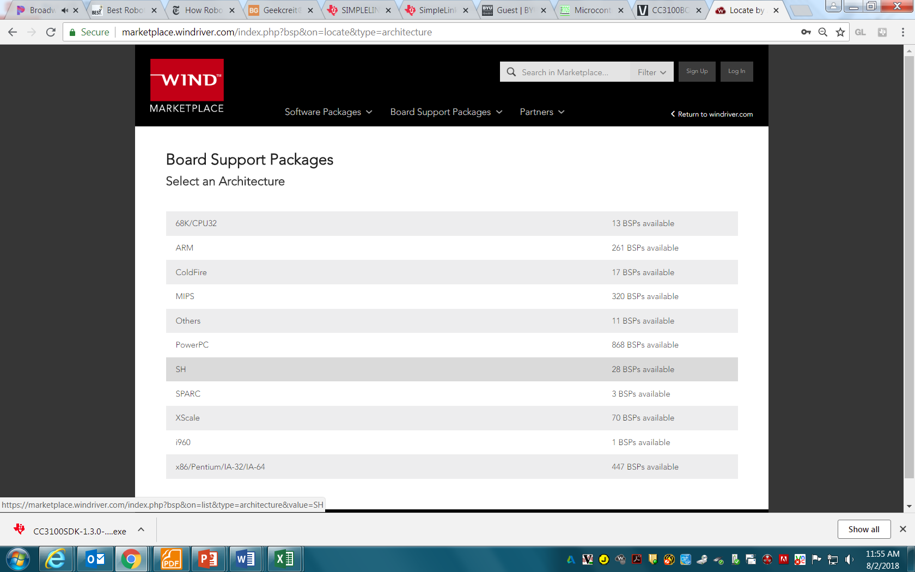
Factors in Choosing the Hardware

Slide 18
Adding Hardware
If you want to integrate off-the-shelf hardware, you have to use standard hardware interfaces.

Slide 19
Adding Hardware
Really Cheap, simple, single thread type implementations:
MSP430 - Booster Packs
AVR/ATMEL - Arduino Shields
PIC - Pic Shields

Slide 20
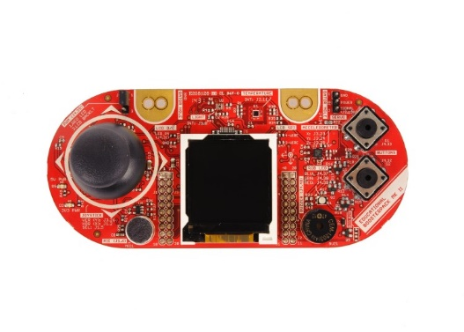
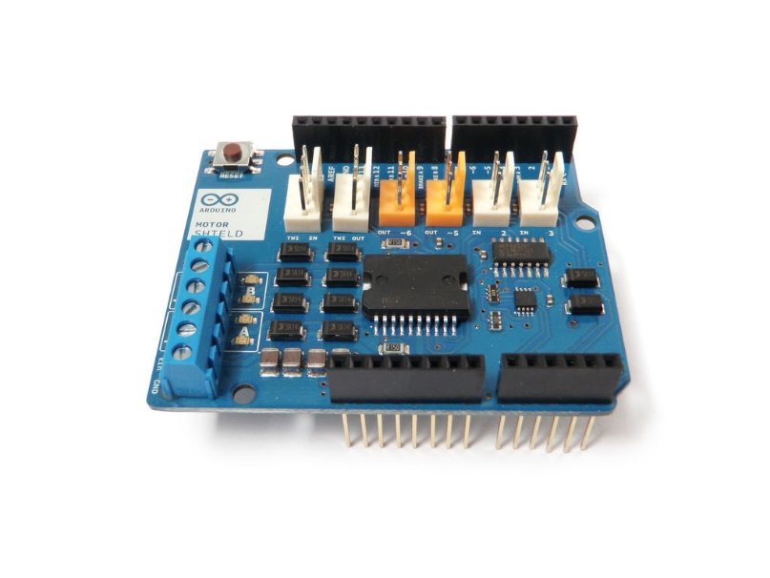
Adding Hardware
Really Cheap, simple, single thread type implementations:

Slide 21
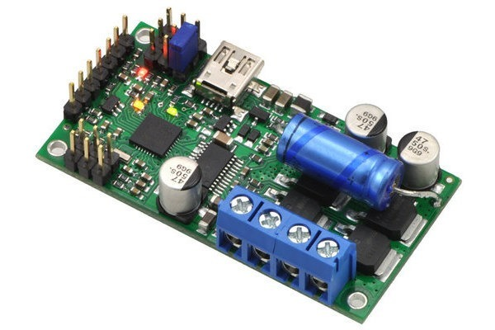
Adding Hardware
Others provide standard interfaces.
USB
UART
I2C
SPI
Bluetooth
Wifi

Slide 22
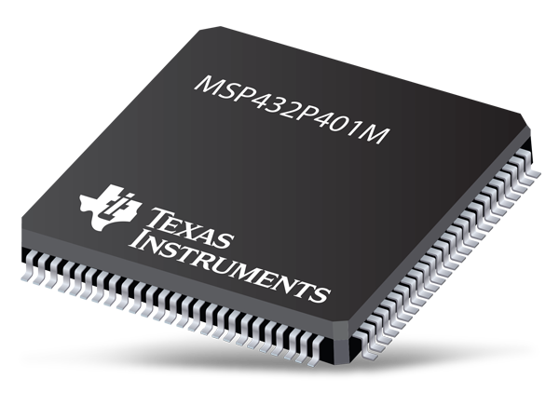
Accessing the Hardware

Slide 23
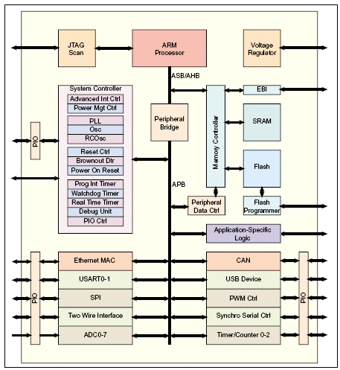
Accessing the Hardware

Slide 24
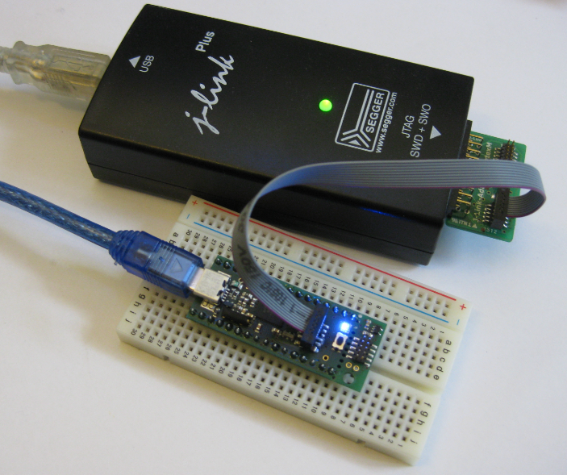
Accessing the Hardware
JTAG is a standard control/test port. It allows the developer to control the processor
Load Code
Run the Code
Add Breakpoints
Take Performance Data

Slide 25
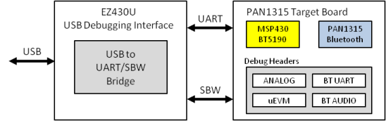
Accessing the Hardware

Slide 26
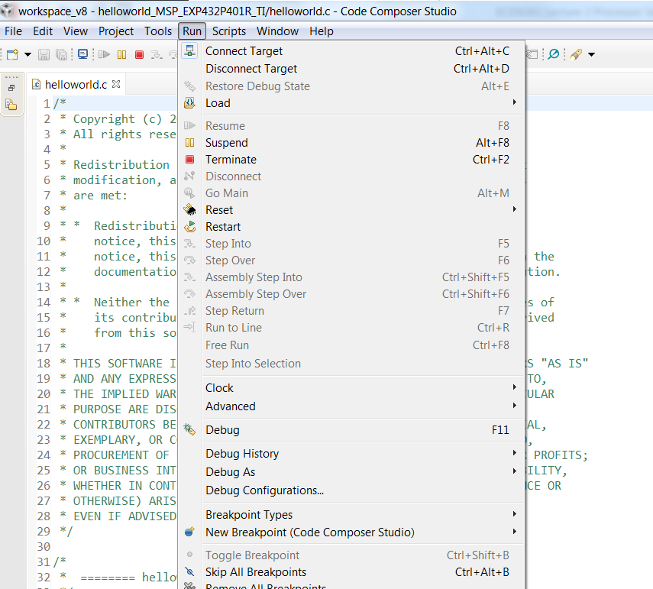
Accessing the Hardware

Slide 27
Accessing the Hardware
Logic Analyzers allow you to access the digital signals on the system
They work very much like oscilloscopes, but only measure ones and zeros, and normally with more than four channels – sometimes many more.

Slide 28
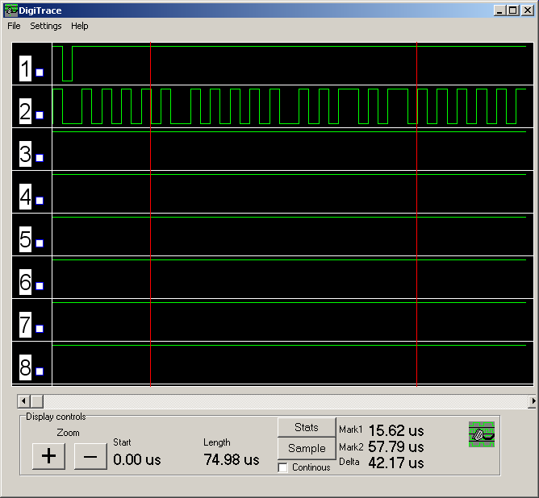
Accessing the Hardware
Logic Analyzers allow you to access the digital signals on the system

Slide 29
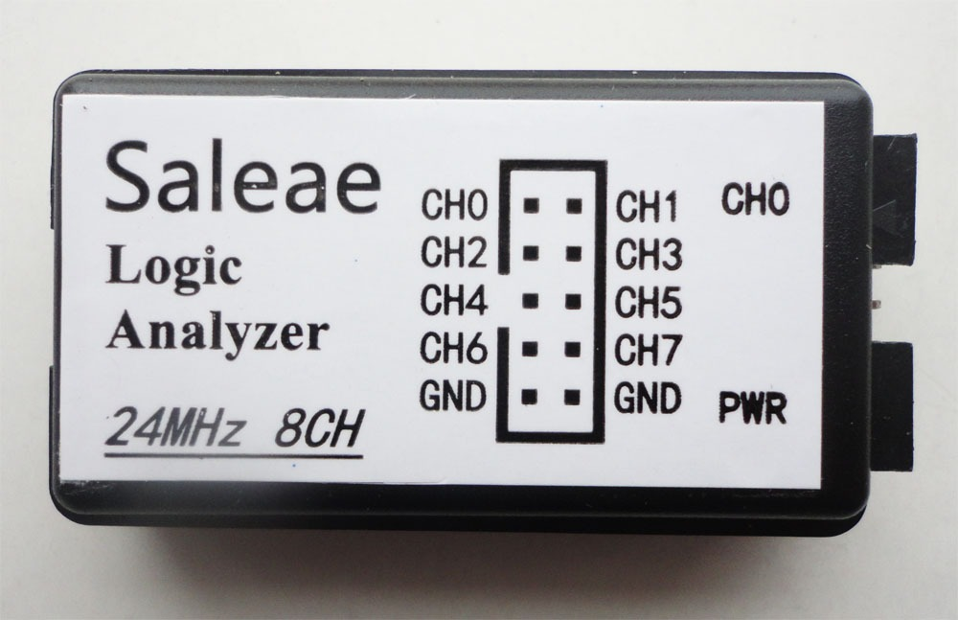
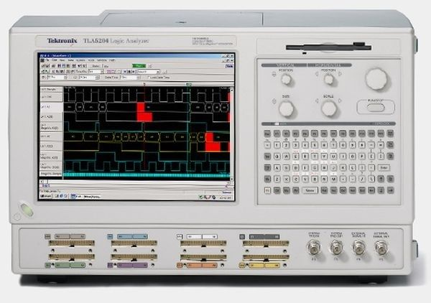
Accessing the Hardware
Logic Analyzers allow you to access the digital signals on the system

